Slide 1
Chapter 9
Managing State Information
PHP Programming with MySQL
2nd Edition

Slide 2
Objectives
In this chapter, you will:
Learn about state information
Use hidden form fields to save state information
Use query strings to save state information
Use cookies to save state information
Use sessions to save state information
PHP Programming with MySQL, 2nd Edition

Slide 3
Understanding State Information
Information about individual visits to a Web site is called state information
HTTP was originally designed to be stateless – Web browsers store no persistent data about a visit to a Web site
Maintaining state means to store persistent information about Web site visits with hidden form fields, query strings, cookies, and sessions
PHP Programming with MySQL, 2nd Edition

Slide 4
Understanding State Information (continued)
Customize individual Web pages based on user preferences
Temporarily store information for a user as a browser navigates within a multipart form
Allow a user to create bookmarks for returning
to specific locations within a Web site
Provide shopping carts that store order information
PHP Programming with MySQL, 2nd Edition

Slide 5
Understanding State Information (continued)
Store user IDs and passwords
Use counters to keep track of how many times
a user has visited a site
The four tools for maintaining state information with PHP are:
  Hidden form fields
  Query strings
  Cookies
  Sessions
PHP Programming with MySQL, 2nd Edition

Slide 6
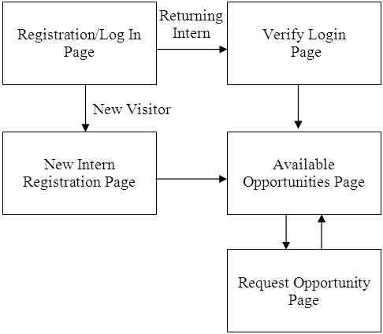
Understanding State Information (continued)
Figure 9-1 College Internship Available Opportunities
Web site page flow
PHP Programming with MySQL, 2nd Edition

Slide 7
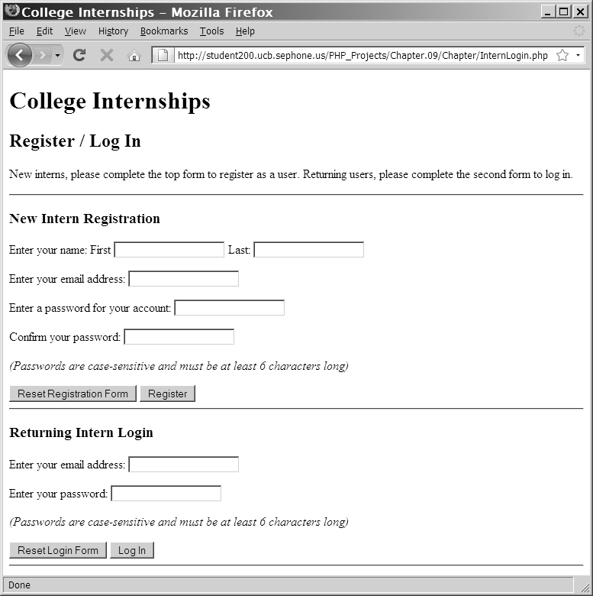
Understanding State Information (continued)
Figure 9-2 Registration/Log In Web page
PHP Programming with MySQL, 2nd Edition

Slide 8
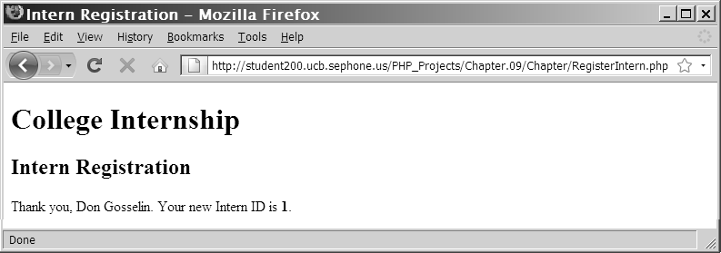
Understanding State Information (continued)
Figure 9-3 New Intern Registration Web page
after successful registration
PHP Programming with MySQL, 2nd Edition

Slide 9
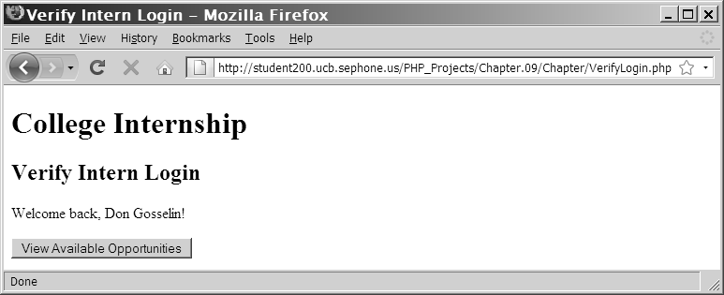
Understanding State Information (continued)
Figure 9-4 Verify Login Web Page for a successful login
PHP Programming with MySQL, 2nd Edition

Slide 10
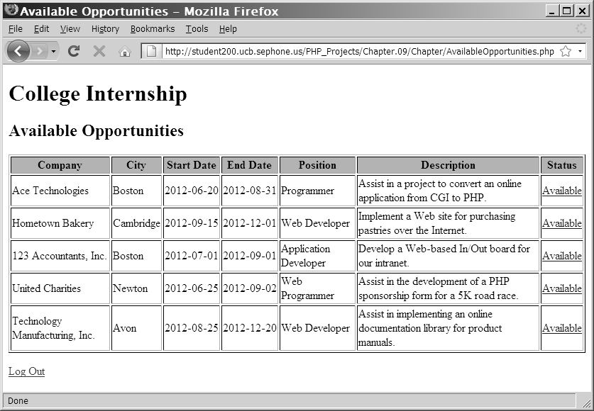
Understanding State Information (continued)
Figure 9-5 The Available Opportunities Web page
with the Intern information at top of screen
PHP Programming with MySQL, 2nd Edition

Slide 11
Using Hidden Form Fields to Save State Information
Create hidden form fields with the <input> element
Hidden form fields temporarily store data that needs to be sent to a server that a user does not need to see
Examples include the result of a calculation
The syntax for creating hidden form fields is:
  <input type="hidden">
PHP Programming with MySQL, 2nd Edition

Slide 12
Using Hidden Form Fields to Save State Information (continued)
Hidden form field attributes are name and value
When submitting a form to a PHP script,
access the values submitted from the form with the $_GET[] and $_POST[] autoglobals
To pass form values from one PHP script to another PHP script, store the values in hidden form fields
PHP Programming with MySQL, 2nd Edition

Slide 13
Using Hidden Form Fields to Save State Information (continued)
echo "<form method='post' " .
" action='AvailableOpportunities.php'>\n";
echo "<input type='hidden' name='internID' " .
" value='$InternID'>\n";
echo "<input type='submit' name='submit' " .
" value='View Available Opportunities'>\n";
echo "</form>\n";
PHP Programming with MySQL, 2nd Edition

Slide 14
Using Query Strings to Save State Information
A query string is a set of name=value pairs appended to a target URL
Consists of a single text string containing one or more pieces of information
Add a question mark (?) immediately after the URL followed by the query string that contains the information you want to preserve in name/value pairs
PHP Programming with MySQL, 2nd Edition

Slide 15
Using Query Strings to Save State Information (continued)
Separate individual name=value pairs within the query string using ampersands (&)
A question mark (?) and a query string are automatically appended to the URL of a server-side script for any forms that are submitted with the GET method
<a href="http://www.example.com/TargetPage
.php?firstName=Don&lastName=Gosselin&
occupation=writer">Link Text</a>
PHP Programming with MySQL, 2nd Edition

Slide 16
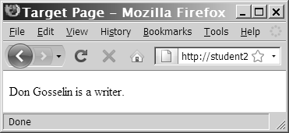
Using Query Strings to Save State Information (continued)
echo "{$_GET['firstName']} {$_GET['lastName']}
is a {$_GET['occupation']}. ";
Figure 9-6 Output of the contents of a query string
PHP Programming with MySQL, 2nd Edition

Slide 17
Using Cookies to Save State Information
Query strings do not permanently maintain
state information
After a Web page that reads a query string closes, the query string is lost
To store state information beyond the current Web page session, Netscape created cookies
Cookies, or magic cookies, are small pieces of information about a user that are stored by a Web server in text files on the user’s computer
PHP Programming with MySQL, 2nd Edition

Slide 18
Using Cookies to Save State Information (continued)
Temporary cookies remain available only for the current browser session
Persistent cookies remain available beyond the current browser session and are stored in a text file on a client computer
Each individual server or domain can store between 20 and 70 cookies on a user’s computer
Total cookies per browser cannot exceed 300
The largest cookie size is 4 kilobytes
PHP Programming with MySQL, 2nd Edition

Slide 19
Creating Cookies
The syntax for the setcookie() function is:
setcookie(name [,value ,expires, path, domain, secure])
You must pass each of the arguments in the order specified in the syntax
To skip the value, path, and domain arguments, specify an empty string as the argument value
To skip the expires and secure arguments, specify 0 as the argument value
PHP Programming with MySQL, 2nd Edition

Slide 20
Creating Cookies (continued)
Call the setcookie() function before sending the Web browser any output, including white space, HTML elements, or output from the echo() or print() statements
Users can choose whether to accept cookies that a script attempts to write to their system
A value of TRUE is returned even if a user rejects the cookie
PHP Programming with MySQL, 2nd Edition

Slide 21
Creating Cookies (continued)
Cookies cannot include semicolons or other special characters, such as commas or spaces, that are transmitted between Web browsers and Web servers using HTTP
Cookies can include special characters when created with PHP since encoding converts special characters in a text string to their corresponding hexadecimal ASCII value
PHP Programming with MySQL, 2nd Edition

Slide 22
The name and value Arguments
Cookies created with only the name and value arguments of the setcookie() function are temporary cookies because they are available for only the current browser session
<?php
setcookie("firstName", "Don");
?>
<!DOCTYPE html PUBLIC "-//W3C//DTD XHTML 1.0 Strict//EN"
"http://www.w3.org/TR/xhtml1/DTD/xhtml1-strict.dtd">
<html xmlns="http://www.w3.org/1999/xhtml">
<head>
<title>College Internships</title>
...
PHP Programming with MySQL, 2nd Edition

Slide 23
The name and value Arguments (continued)
The setcookie() function can be called multiple times to create additional cookies – as long as the setcookie() statements come before any other output on a Web page
  setcookie("firstName", "Don");
  setcookie("lastName", "Gosselin");
  setcookie("occupation", "writer");
PHP Programming with MySQL, 2nd Edition

Slide 24
The name and value Arguments (continued)
The following code creates an indexed cookie array named professional[] that contains three cookie values:
  setcookie("firstName", "Don");
  setcookie("lastName", "Gosselin");
  setcookie("occupation", "writer");
PHP Programming with MySQL, 2nd Edition

Slide 25
The name and value Arguments (continued)
The following code creates an associative cookie array named professional[] that contains three cookie values:
setcookie("professional['firstName']", "Don");
setcookie("professional['lastName']", "Gosselin");
setcookie("professional['occupation']", "writer");
PHP Programming with MySQL, 2nd Edition

Slide 26
The expires Argument
The expires argument determines how long a cookie can remain on a client system before it is deleted
Cookies created without an expires argument are available for only the current browser session
To specify a cookie’s expiration time, use PHP’s time() function
setcookie("firstName", "Don", time()+3600);
PHP Programming with MySQL, 2nd Edition

Slide 27
The path Argument
The path argument determines the availability of a cookie to other Web pages on a server
Using the path argument allows cookies to be shared across a server
A cookie is available to all Web pages in a specified path as well as all subdirectories in the specified path
setcookie("firstName", "Don", time()+3600, "/marketing/");
PHP Programming with MySQL, 2nd Edition

Slide 28
The domain Argument
The domain argument is used for sharing cookies across multiple servers in the same domain
Cookies cannot be shared outside of a domain
setcookie("firstName", "Don”, time()+3600, "/", ".gosselin.com");
PHP Programming with MySQL, 2nd Edition

Slide 29
The secure Argument
The secure argument indicates that a cookie can only be transmitted across a secure Internet connection using HTTPS or another security protocol
To use this argument, assign a value of 1 (for TRUE) or 0 (for FALSE) as the last argument of the setcookie() function
setcookie("firstName”, "Don", time()+3600, "/", ".gosselin.com", 1);
PHP Programming with MySQL, 2nd Edition

Slide 30
Reading Cookies
Cookies that are available to the current Web page are automatically assigned to the $_COOKIE autoglobal
Access each cookie by using the cookie name as a key in the associative $_COOKIE[] array
echo $_COOKIE['firstName'];
Newly created cookies are not available until after the current Web page is reloaded
PHP Programming with MySQL, 2nd Edition

Slide 31
Reading Cookies (continued)
To ensure that a cookie is set before you attempt to use it, use the isset() function
setcookie("firstName", "Don");
setcookie("lastName", "Gosselin");
setcookie("occupation", "writer");
if (isset($_COOKIE['firstName'])
&& isset($_COOKIE['lastName'])
&& isset($_COOKIE['occupation']))
echo "{$_COOKIE['firstName']} {$_COOKIE['lastName']}
is a {$_COOKIE['occupation']}.";
PHP Programming with MySQL, 2nd Edition

Slide 32
Reading Cookies (continued)
Use multidimensional array syntax to read
each cookie value
setcookie("professional[0]", "Don");
setcookie("professional[1]", "Gosselin");
setcookie("professional[2]", "writer");
if (isset($_COOKIE['professional']))
echo "{$_COOKIE['professional'][0]}
{$_COOKIE['professional'][1]} is a
{$_COOKIE['professional'][2]}.";
PHP Programming with MySQL, 2nd Edition

Slide 33
Deleting Cookies
To delete a persistent cookie before the time assigned to the expires argument elapses, assign a new expiration value that is sometime in the past
Do this by subtracting any number of seconds from the time() function
setcookie("firstName", "", time()-3600);
setcookie("lastName", "", time()-3600);
setcookie("occupation", "", time()-3600);
PHP Programming with MySQL, 2nd Edition

Slide 34
Using Sessions to Save State Information
Spyware gathers user information from a local computer for marketing and advertising purposes without the user’s knowledge
A session refers to a period of activity when a PHP script stores state information on a Web server
Sessions allow you to maintain state information even when clients disable cookies in their Web browsers
PHP Programming with MySQL, 2nd Edition

Slide 35
Starting a Session
The session_start() function starts a new session or continues an existing one
The session_start() function generates a unique session ID to identify the session
A session ID is a random alphanumeric string that looks something like:
7f39d7dd020773f115d753c71290e11f
The session_start() function creates a text file on the Web server that is the same name as the session ID, preceded by sess_
PHP Programming with MySQL, 2nd Edition

Slide 36
Starting a Session (continued)
Session ID text files are stored in the Web server directory specified by the session.save_path directive in your php.ini configuration file
The session_start() function does not accept any arguments, nor does it return a value that you can use in your script
<?php
session_start();
...
PHP Programming with MySQL, 2nd Edition

Slide 37
Starting a Session (continued)
You must call the session_start() function before you send the Web browser any output
If a client’s Web browser is configured to accept cookies, the session ID is assigned to a temporary cookie named PHPSESSID
Pass the session ID as a query string or hidden form field to any Web pages that are called as part of the current session
PHP Programming with MySQL, 2nd Edition

Slide 38
Starting a Session (continued)
<?php
session_start();
...
?>
<p><a href='<?php echo "Occupation.php?PHPSESSID="
. session_id() ?>'>Occupation</a></p>
PHP Programming with MySQL, 2nd Edition

Slide 39
Working with Session Variables
Session state information is stored in the $_SESSION autoglobal
When the session_start() function is called, PHP either initializes a new $_SESSION autoglobal or retrieves any variables for the current session (based on the session ID) into the $_SESSION autoglobal
PHP Programming with MySQL, 2nd Edition

Slide 40
Working with Session Variables (continued)
<?php
session_start();
$_SESSION['firstName'] = "Don";
$_SESSION['lastName'] = "Gosselin";
$_SESSION['occupation'] = "writer";
?>
<p><a href='<?php echo "Occupation.php?"
. session_id() ?>'>Occupation</a></p>
PHP Programming with MySQL, 2nd Edition

Slide 41
Working with Session Variables (continued)
Use the isset() function to ensure that a session variable is set before you attempt to
use it
<?php
session_start();
if (isset($_SESSION['firstName']) && isset($_SESSION['lastName'])
&& isset($_SESSION['occupation']))
echo "<p>" . $_SESSION['firstName'] . " "
. $_SESSION['lastName'] . " is a "
. $_SESSION['occupation'] . "</p>";
?>
PHP Programming with MySQL, 2nd Edition

Slide 42
Deleting a Session
To delete a session manually, perform the following steps:
1. Execute the session_start() function
2. Use the array() construct to reinitialize the
$_SESSION autoglobal
3. Use the session_destroy() function to
delete the session
PHP Programming with MySQL, 2nd Edition

Slide 43
Deleting a Session (continued)
  <?php
  session_start();
  $_SESSION = array();
  session_destroy();
  ?>
PHP Programming with MySQL, 2nd Edition

Slide 44
Summary
Information about individual visits to a Web site is called state information. Maintaining state means to store persistent information about Web site visits
To pass form values from one PHP script to another, you can store the values in hidden form fields, which are submitted along with other types of form fields
PHP Programming with MySQL, 2nd Edition

Slide 45
Summary (continued)
One way to preserve information following a user’s visit to a Web page is to append a query string to the end of a URL. To pass information from one Web page to another using a query string, add a question mark (?) immediately after a URL, followed by the query string containing the information you want to preserve in name/value pairs.
PHP Programming with MySQL, 2nd Edition

Slide 46
Summary (continued)
Cookies, also called magic cookies, are small pieces of information about a user that are stored by a Web server in text files on the user’s computer. Cookies can be temporary or persistent.
  Temporary cookies remain available only for the current browser session
  Persistent cookies remain available beyond the current browser session and are stored in a text file on a client computer
PHP Programming with MySQL, 2nd Edition

Slide 47
Summary (continued)
You use the setcookie() function to create cookies in PHP. You must call the setcookie() function before you send the Web browser any output, including white space, HTML elements, or output from the echo or print statements.
Cookies created with only the name and value arguments of the setcookie() function are temporary cookies, because they are available for only the current browser session
PHP Programming with MySQL, 2nd Edition

Slide 48
Summary (continued)
For a cookie to persist beyond the current browser session, you must use the expires argument with the setcookie() function
The path argument of the setcookie() function determines the availability of a cookie to other Web pages on a server
The secure argument of the setcookie() function indicates that a cookie can only be transmitted across a secure Internet connection using HTTPS or another security protocol
PHP Programming with MySQL, 2nd Edition

Slide 49
Summary (continued)
To delete a persistent cookie before the time elapses in the assigned expires argument, assign a new expiration value to a time in the past and clearing the value. You do this by subtracting any number of seconds from the time() function and setting the value of the cookie to the empty string.
PHP Programming with MySQL, 2nd Edition

Slide 50
Summary (continued)
Sessions refer to periods of activity when a PHP script stores state information on a Web server. When you start a new session, the session_start() function generates a unique session ID to identify the session. If a client’s Web browser is configured to accept cookies, the session ID is assigned to a temporary cookie named PHPSESSID.
PHP Programming with MySQL, 2nd Edition

Slide 51
Summary (continued)
You must call the session_start() function before you send the Web browser any output, including white space, HTML elements, or output from the echo or print statements
You store session state information in the $_SESSION[] autoglobal
PHP Programming with MySQL, 2nd Edition

Slide 52
Summary (continued)
To delete a session, execute the session_start() function, use the array[] construct to reinitialize the $_SESSION[] autoglobal and call the session_destroy() function
PHP Programming with MySQL, 2nd Edition

